Slide 1
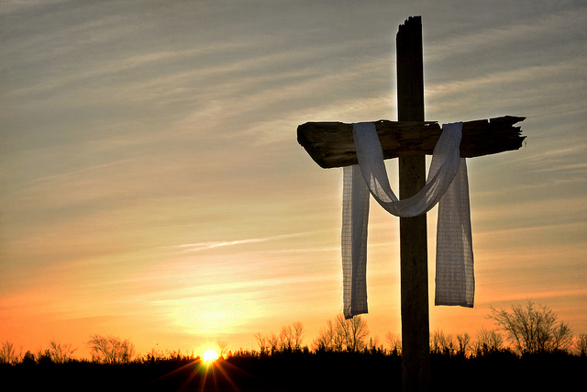
Understanding Easter
Mark 15:33-16:8
I. A Dark Day v. 33
“sixth hour = “noon”
the height of the day
Notes:
I. A Dark Day v. 33
“sixth hour = “noon”
the height of the day

Slide 2
Understanding Easter
Mark 15:33-16:8
A Loud Cry
vv. 34-37
The Consequence of sin
is to be forsaken by God
Notes:
A Loud Cry
vv. 34-37
The Consequence of sin
is to be forsaken by God

Slide 3
Understanding Easter
Mark 15:33-16:8
A Torn Curtain
v. 38
The curtain stood
between God and man!
It stood as protection
into the Lord’s presence.
Notes:
A Torn Curtain
v. 38
The curtain stood
between God and man!
It stood as protection
into the Lord’s presence.

Slide 4
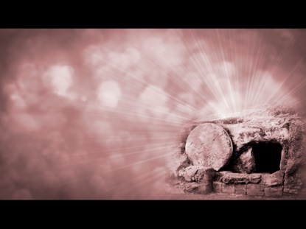
Understanding Easter
Mark 15:33-16:8
The Empty Tomb 16:1-8
The empty
tomb proves
all that
He said
He was!
Notes:
The Empty Tomb 16:1-8
The empty
tomb proves
all that
He said
He was!

Slide 5
Understanding Easter
Mark 15:33-16:8
Application:
What does
Easter
mean to
YOU?
Notes:
Application:
What does
Easter
mean to
YOU?

