Slide 1
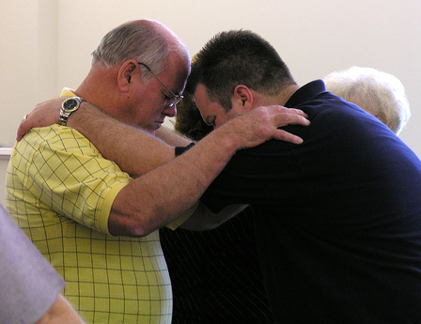
Motivation for Spiritual Ministry Romans 1:8-17
Mutual Encouragement vv. 8-13
a. Thankfulness v. 8
b. Longing vv. 9-11
Sense of Obligation
vv. 13-15
Notes:
Mutual Encouragement vv. 8-13
a. Thankfulness v. 8
b. Longing vv. 9-11
Sense of Obligation
vv. 13-15

Slide 2
Motivation for Spiritual Ministry Romans 1:8-17
Conviction of the Power of the
Gospel vv. 16-17
“For He made Him who knew no sin
to be sin for us, that we
might become the
righteousness of
God in Him.”
2 Corinthians 5:21
Notes:
Conviction of the Power of the
Gospel vv. 16-17
“For He made Him who knew no sin
to be sin for us, that we
might become the
righteousness of
God in Him.”
2 Corinthians 5:21

Slide 3
Motivation for Spiritual Ministry Romans 1:8-17
Applications:
Do you have the power of God in your life?
Do you realize you are a debtor to all men to share what God has done
for you?
Purpose not to be
ashamed of what
the Lord has done in
your life!
Notes:
Applications:
Do you have the power of God in your life?
Do you realize you are a debtor to all men to share what God has done
for you?
Purpose not to be
ashamed of what
the Lord has done in
your life!

